Slide 1


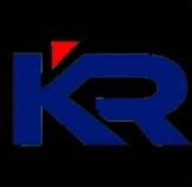

K.RAMAKRISHNAN COLLEGE OF ENGINEERING
An Autonomous Institution
Permanently affiliated to ANNA University Chennai, Approved by AICTE New Delhi,
Accredited By NBA and with A Grade by NAAC
AI TRISM : TRUST,RISK AND SECURITY MANAGEMENT IN ARTIFICIAL INTELLIGENCE
DEPT : Computer Science And Business Systems

Slide 2



BATCH 06
PRESENTED BY :
ARTHY M (8115U22CB007)
REENA S (8115U22CB044)
SHREE HARINI S (8115U22CB050)
SOUNDARYA AL (8115U22CB052)

Slide 3
INTRODUCTION TO AI
Artificial Intelligence, or AI, is the ability of machines to mimic human intelligence. It involves creating systems that can learn from data, recognize patterns, make decisions, and improve over time. AI is used in everyday applications like voice assistants, recommendation engines, and autonomous vehicles. Its goal is to perform tasks that typically require human intelligence, helping improve accuracy, speed, and efficiency across industries.

Slide 4

AI trust, risk and security management (AI TRiSM) ensures AI governance, trustworthiness, fairness, reliability, robustness, efficacy and data protection. AI TRiSM includes solutions and techniques for model and application transparency, content anomaly detection, AI data protection, model and application monitoring and operations, adversarial attack resistance and AI application security.
WHAT IS AI TRISM ?

Slide 5


The main objective of AI TRiSM is to ensure that AI systems operate in a secure, ethical, and transparent manner. It aims to reduce risks associated with AI, such as bias, privacy breaches, and lack of accountability. It promotes the development of explainable and trustworthy AI models that users can understand and rely on. AI TRiSM also ensures compliance with legal and regulatory standards. Overall, it helps build responsible AI systems that align with organizational values and protect users from harm.
OBJECTIVES OF AI TRISM

Slide 6

KEY ELEMENTS OF AI TRISM
Makes AI decisions understandable and transparent to users and stakeholders.
EXPLAINABILITY
DATA PRIVACY MANAGEMENT
Safeguards sensitive user data and ensures compliance with privacy laws.
Protects AI systems from cyber threats and unauthorized access.
SECURITY
Ensures responsible development, deployment, and oversight of AI systems.
GOVERNANCE
COMPLIANCE AND ETHICS
Aligns AI usage with legal, ethical, and organizational standards.

Slide 7


TRUST IN AI
Trust in AI TRiSM is about building confidence in the entire AI lifecycle through effective management of risks, transparency, and ethical practices. It ensures that AI systems are not only technically sound but also align with human values and societal norms. By focusing on governance, fairness, explainability, and security, AI TRiSM helps organizations create AI that people can rely on. It promotes responsible use of AI by making sure systems are understandable, accountable, and respectful of privacy, which ultimately strengthens user trust and acceptance.

Slide 8

RISK IN AI
Risk in AI TRiSM refers to the potential challenges and negative outcomes that can arise if trust, security, and ethical principles are not properly managed in AI systems. These risks include model inaccuracy, data breaches, algorithmic bias, and non-compliance with regulations. Without proper oversight, AI may produce unreliable or harmful results. There’s also a risk of lack of explainability, making it difficult to understand or justify AI decisions. AI TRiSM addresses these issues by implementing controls that ensure AI systems remain secure, fair, and aligned with organizational and societal expectations.

Slide 9
SECURITY IN AI
Security in AI TRiSM ensures that AI systems are protected from threats throughout their entire lifecycle. It involves safeguarding data, models, and processes from cyberattacks, manipulation, and unauthorized access. AI TRiSM focuses on identifying security vulnerabilities early, implementing robust defenses, and continuously monitoring for risks. It also includes practices like secure model deployment, access control, and encryption. By integrating security into AI governance, AI TRiSM helps organizations maintain the integrity, reliability, and trustworthiness of their AI systems.

Slide 10

AI GOVERNANCE
AI governance refers to the policies, processes, and structures that guide the development, deployment, and use of artificial intelligence (AI). It aims to ensure AI systems are safe, ethical, trustworthy, and compliant with legal and societal norms. This includes addressing issues like bias, privacy, security, and accountability.

Slide 11

REGULATORY COMPLILANCE
Regulatory compliance in AI means ensuring that AI systems follow all relevant laws, standards, and guidelines set by governments and industry bodies. This includes data protection laws like GDPR, ethical standards, and sector-specific regulations. Compliance helps prevent legal issues, protects user rights, and promotes fairness and transparency. It also involves proper documentation, audit trails, and risk assessments. By integrating compliance into the AI development process, organizations can avoid penalties, build public trust, and ensure responsible use of AI technologies.

Slide 12

MODEL EXPLAINABILITY
Model explainability, also known as explainable AI (XAI), refers to the ability of a machine learning model to provide clear and understandable explanations for its decisions and predictions. It's about making complex AI models more transparent and interpretable to humans, enabling them to understand the reasoning behind the model's output. This is crucial for building trust in AI systems, fostering accountability, and addressing ethical concerns.

Slide 13
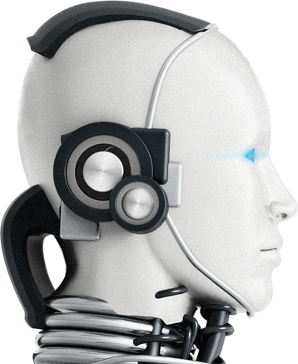
CONTINUOUS MONITORING
Continuous monitoring is a real-time observation and analysis of various aspects, including cybersecurity, network performance, and operational efficiency, using automated tools and processes. It involves constantly collecting, analyzing, and acting on data to detect and mitigate potential issues promptly.

Slide 14

DATA PRIVACY IN AI
Data privacy in AI refers to the practices and concerns surrounding the ethical collection, storage, and use of personal information by artificial intelligence systems. It's about protecting individual data rights and ensuring confidentiality as AI algorithms process vast amounts of personal data. AI privacy is crucial because the data used to train AI models can include sensitive information like health records, financial data, and biometric data.

Slide 15

BIAS AND FAIRNESS
Bias in AI occurs when the system produces unfair or prejudiced outcomes due to imbalanced or flawed training data. It can lead to discrimination against certain groups and affect decision-making in areas like hiring, lending, or law enforcement.
Fairness in AI means ensuring that all individuals are treated equally and that AI decisions do not favor or harm any specific group. It involves using diverse data, testing for bias, and adjusting models to promote equality

Slide 16
AI TRISM IN ACTION
Healthcare
1. Explainable diagnosis suggestions: AI systems provide transparent and interpretable diagnosis suggestions, enabling doctors to understand the reasoning behind the recommendations.
2. Personalized medicine: AI TRiSM ensures that personalized treatment plans are fair, secure, and respectful of patient data.
Finance
1. Fraud detection with fair decisioning: AI-powered fraud detection systems are designed to detect suspicious activity while minimizing bias and ensuring fairness.
2. Risk assessment: AI TRiSM enables financial institutions to assess risk while maintaining transparency and accountability.
HR
1. Bias-free hiring: AI-powered recruitment tools are designed to minimize bias and ensure fairness in the hiring

Slide 17
BENEFITS OF AI TRISM
1. Increases trust: Builds confidence among users.
2. Reduces risk: Minimizes errors and biases.
3. Promotes innovation: Encourages responsible AI development.

Slide 18
CHALLENGES
1. Hard to understand: Some AI models are like black boxes, making it difficult to know how they make decisions.
2. Lack of trust: If we don't understand how AI works, we might not trust its decisions.
3. Regulatory issues: Some industries require explanations for AI decisions.

Slide 19
TOOLS & TECHNIQUES FOR AI TRISM
1. Model monitoring: Tracks AI performance.
2. Explainable AI: Provides insights into AI decisions.
3. Fairness and bias detection: Identifies and mitigates biases.

Slide 20
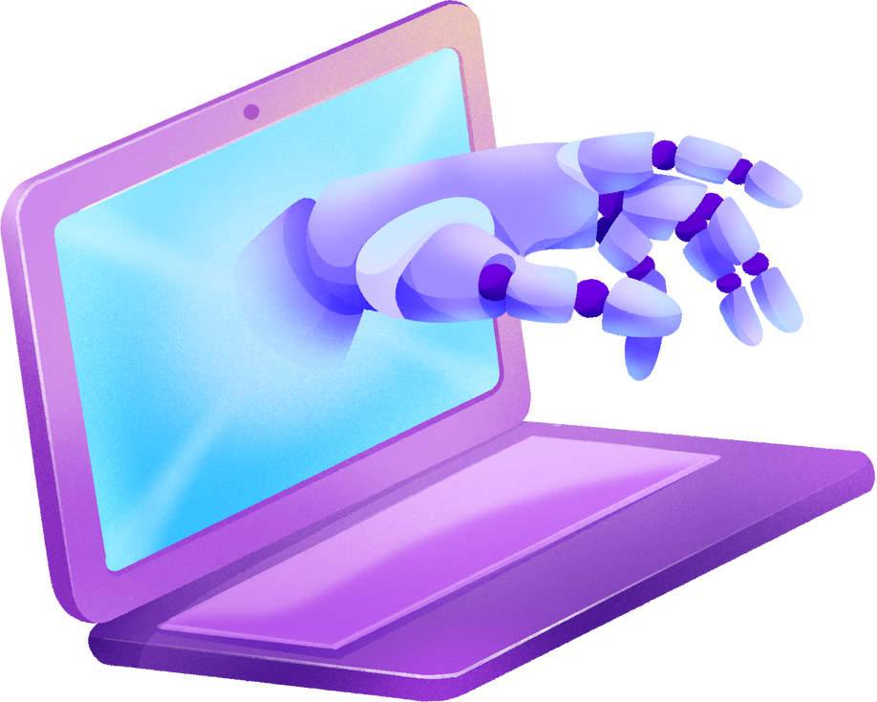
FUTURE OF AI TRISM
1. Future of AI: AI TRiSM will be essential for responsible AI development.
2. Global adoption: Expect widespread adoption across industries.

Slide 21
AI TRiSM plays a vital role in ensuring that artificial intelligence is developed and used in a way that is secure, ethical, and trustworthy. By focusing on transparency, risk management, privacy, and fairness, organizations can build AI systems that are reliable and aligned with human values. As AI continues to grow, adopting AI TRiSM practices will be essential for gaining user trust, meeting regulations, and achieving long-term success with AI technologies.
CONCLUSION

Slide 22

THANK YOU!

